Slide 1
Service Consumer Patterns
How to talk to microservices.

Slide 2
Agenda
Commands and Queries with a Monolith
The Challenge with Microservices
Queries: Composition
Commands: Conversations
Summary

Slide 3
Who are you?
Software Developer for more than 20 years
Worked mainly for ISVs
Reuters, SunGard, Misys, Huddle
Worked for a couple of MIS departments
DTI, Beazley
Microsoft MVP for C#
Interested in architecture and design
Interested in Agile methodologies and practices
No smart guys
Just the guys in this room

Slide 4
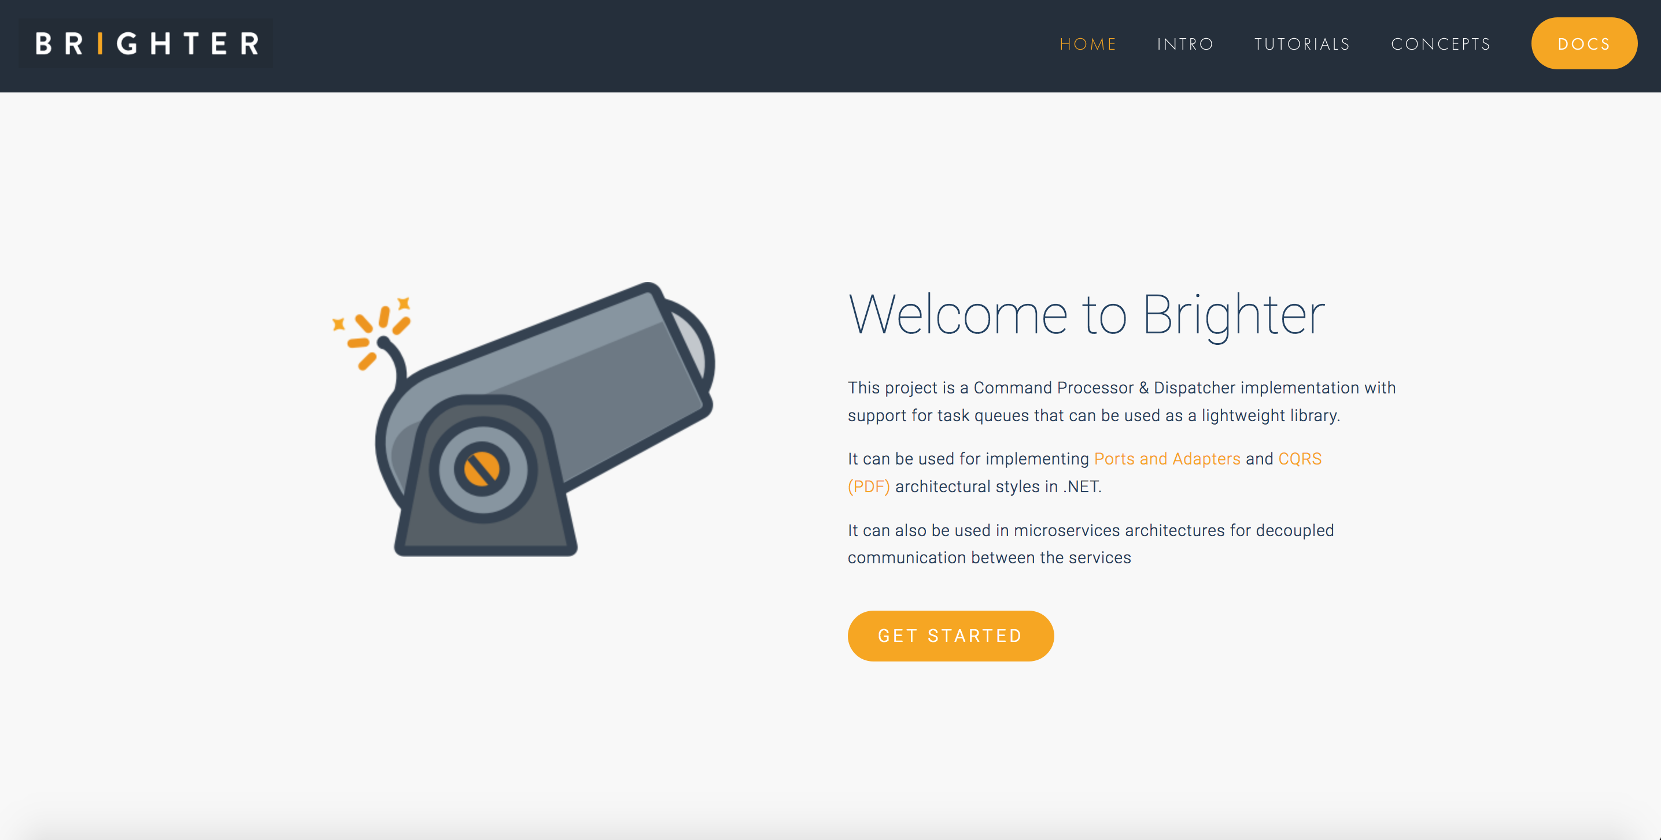

Slide 5
See also: Event Driven Collaboration

Slide 6
Monoliths: Queries & Commands

Slide 7
Monolith
System Boundary
Web
Web
Web
API
API
API
API
Worker
Shared Database Integration
Worker
Db
Notes:
What is a Monolith?
Generally, we tend to define a monolith as a system that uses shared database integration between components that have different reasons to change. In this diagram, we may have even multiple application containers for our code, but because all these components share the same database – they may have to be deployed together. A monolith is not simply a single container, hosting multiple APIs, it could even be several containers, hosting one or more APIs each along workers, allowing independent scaling of its parts! A monolith however does not have a deployment boundary which is less than the whole system.
(Now, we can often figure out which containers are impacted by a change, and set up our system to deploy just those. And most of the time this works – until it doesn’t. But we have to do work to understand that as part of our release process).
And this can be painful, at scale, where we have multiple teams all wanting to deploy at the same time…

Slide 8
A Monolith
API
Presentation
Direct
Bookings
Credit Card
Payments
Accounts
Housekeeping
Channel Manager
Domain
ORM
Data
Db
Notes:
In a typical monolithic application, we might divide up our system into three layers.
Presentation: The widgets, in this case our HTTP API, but might it might have been server-side rendered HTML etc.
Domain: The application and domain logic
Data: Access to our persistent storage
Let us imagine that we have a request for a direct booking on account. To service this request, we would probably call some application logic in a service/command in direct bookings. The application logic there would load the data we needed to complete the operation, so the account details with the credit card information, so that we could then take a credit card payment. In turn we would then update the direct booking and probably call Housekeeping and Channel Manager to update their records of the number of available rooms.
Now, there is a lot going on, but we never had to worry about how we accessed the data at any step, we just read or wrote it to the db

Slide 9

Commands

Slide 10
Getting work done in a Monolith
{POST: New Booking}
{Call Channels}
{Call Payment Provider}
API
Presentation
{Create New Booking}
{Take Payment}
{Inform Channels}
Housekeeping
Channel Manager
Direct
Bookings
Credit Card
Payments
Accounts
{Ready Housekeeping}
{Update Booking}
{Get CC Details}
{Create Account Objects}
{Write Housekeeping}
Domain
{Write New Booking}
{Get Channels}
ORM
Data
{Read/Write Rows}
Db
Notes:
In a typical monolithic application, we might divide up our system into three layers.
Presentation: The widgets, in this case our HTTP API, but might it might have been server-side rendered HTML etc.
Domain: The application and domain logic
Data: Access to our persistent storage
Let us imagine that we have a request for a direct booking on account. To service this request, we would probably call some application logic in a service/command in direct bookings. The application logic there would load the data we needed to complete the operation, so the account details with the credit card information, so that we could then take a credit card payment. In turn we would then update the direct booking and probably call Housekeeping and Channel Manager to update their records of the number of available rooms.
Now, there is a lot going on, but we never had to worry about how we accessed the data at any step, we just read or wrote it to the db

Slide 11

Queries

Slide 12
Getting work done in a Monolith
{Get: Check-In Details}
API
Presentation
{Create Query}
Accounts
Housekeeping
…
Queries
Domain
ORM
{Query Accounts and Housekeeping using a join}
Data
Db
Notes:
Now, imagine we are building a good monolith. We might well have used CQRS. So instead of going through the Command Model, we are just going to query for the data we need, in the shape we need, from the database. (Let’s ignore for now, any complexity of whether we are reading the same rows as the Commands, or creating some projection based on their writes, the point remains the same either way, so let’s show it simply).
We can just query the database, and use a join to get the data we need. It’s all there. Querying for data to answer a query on an API is simple.

Slide 13
The Challenge with Microservices

Slide 14
SOA (Microservices)
Compatibility by Policy
Service Boundary
Web
Worker
API
Services are Autonomous
Boundaries are Explicit
Single Writer
Db
Share Schema not Type
Notes:
Microservices: SOA -> Guerilla SOA (Jim Webber) -> Microservices (Fred George – Programmer Anarchy)
Fowler and Lewis: Microservices -> Much more Jim Webber Guerilla SOA than Fred George “I sing the body microservices”
Services: hide code and data, expose only documented message formats for communication
Decoupling is the reason for this.
Depend upon abstractions, don’t depend on details
4 tenets of SOA, still applicable to microservices
Boundaries are explicit
Services are autonomous
Share Schema Not Type
Compatibility is based on Policy
But adds some new relevant ones like Bounded Context (a CI boundary)
A service is the ‘system of record’ for some part of our system
There is only a single writer of that data - this service
Often a service owns a bounded context, not just one entity or aggregate
Everyone else must ask the service for data, or listen to the service for data
Although we clearly own create, update, and delete it can be a little less obvious that we own Read.
Remember that we are trying to reduce coupling between services to allow independent deployment, so we don’t want to share schema out of the service. So our read is a stable contract, a view of our data. Because downstream clients may be hard to change, and we might want to restructure around new capabilities or algorithms then we need to insulate our internals from the external read data, and ensure that whilst that is long-lived it is not limiting our ability to change our internals

Slide 15
What is a microservice?
SOA is focused on business processes… a service should represent a self-contained functionality that corresponds to a real-world business activity.
Josuttis, Nicolai M.. SOA in Practice: The Art of Distributed System Design . O'Reilly Media. Kindle Edition.
Notes:
Whilst this is SOA advice, we are taking the view that microservices are just SOA 3.0, and as such, most of the best practice still applies
The key here is to understand that we want service alignment with a business process or activity. Whilst services offer us benefits such as fault-tolerance through isolation, that is not the thrust of this workstream. Instead this workstream is looking at how microservices improve our productivity, when we get alignment between a service and a business process.
We amplify this point in the next slide, which talks about the entity service anti-pattern

Slide 16
Microservices
Direct
Bookings
Credit Card
Payments
Accounts
Housekeeping
Channel Manager
API
API
API
API
API
Db
Db
Db
Db
Db
Notes:
A service publishes an event to a broker – usually using a topic or similar identifier
A consumer subscribes to that topic on the broker and receives messages
The channel usually offers guaranteed at least once delivery avoiding the issue of temporal coupling

Slide 17
Commands

Slide 18
Partner
Client
{POST: New Booking}
Perimeter
{GET: CC Details}
Gateway
{POST: Reduce Availability }
{POST: Take Payment}
{POST: Reserve Room }
Direct
Bookings
Credit Card
Payments
Accounts
Housekeeping
Channel Manager
API
API
API
API
API
Db
Db
Db
Db
Db
Bus
Notes:
We can think about a microservice architecture as possessing a number of layers.
Client: Native, Web or User Agent, but also partner organizations using APIs from outside the perimeter
Perimeter: The line between internal and external systems
Gateway: A microservice is oriented around a business function, and owns its own data.
Now, what happens with microservices?
Naively we might,
Use the API to call direct bookings and make the booking
Go to accounts to retrieve the user’s credit card information
Present that to the credit card payments system and, if that works
Reserve a room with housekeeping
And update the channel manager

Slide 19
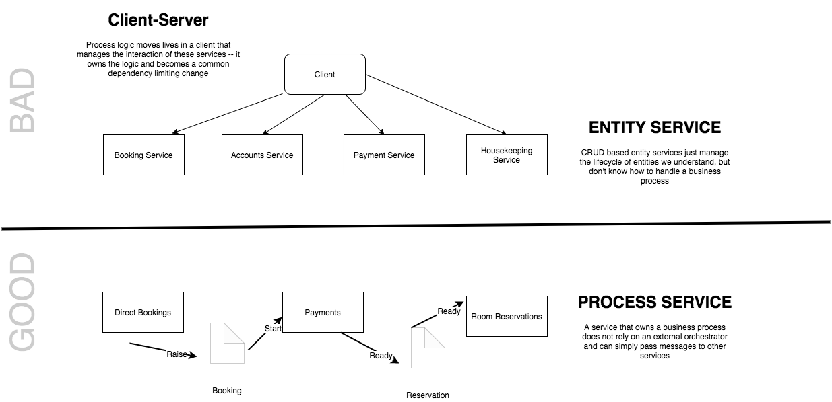
The Entity Service Problem
See Avoiding the Entity Service, Michael Nygard
Notes:
We need to be cautious of modeling microservices by looking for entities in our system and wrapping them with an API. This model tends to result in ‘feature envy’ as the business process logic creeps out of the service and into a Gateway orchestrator. Often this creates temporally coupled services, or the need to copy a lot of data in projections between services. By focusing on a process we can make our services more self-contained and more effectively use messaging to communicate.
Sometimes things just are an entity service, but they tend to be sources of reference data cached locally by other services to do their work

Slide 20
Partner
Client
{POST: 200ms}
Perimeter
{GET: 100ms}
Gateway
{POST: 1500ms }
{POST: 1500ms}
{POST: 200ms }
Direct
Bookings
Credit Card
Payments
Accounts
Housekeeping
Channel Manager
API
API
API
API
API
Db
Db
Db
Db
Db
Bus
Notes:
The latency for the client is the sum of all the operations
A simple write might be 200 ms
A simple read might be 100ms
But if I have to talk to a 3rd party we might suddenly take 1500ms
The client could be spinning for almost 4s in this model, because the latency of those calls adds up.
…
And the client might only care about the booking, not the whole process end-to-end, and be happy to be notified of failure asynchronously

Slide 21
Queries

Slide 22
Partner
Client
{GET: Booking Details}
Perimeter
{GET: 100ms}
Gateway
{GET: 100ms}
{GET: 100ms}
Direct
Bookings
Credit Card
Payments
Accounts
Housekeeping
Channel Manager
API
API
API
API
API
Db
Db
Db
Db
Db
Bus
Notes:
We can think about a microservice architecture as possessing a number of layers.
Client: Native, Web or User Agent, but also partner organizations using APIs from outside the perimeter
Perimeter: The line between internal and external systems
Gateway: A microservice is oriented around a business function, and owns its own data.
If we just want to get the customer booking details, it doesn’t seem so bad. Surely at this point, we can just grab the data from the backend services and merge it on the front end
The first problem is that the client needs to run the logic to interpolate the results. The second problem is latency again, particularly for mobile apps.

Slide 23
Reads: Composition

Slide 24
Partner
Client
Perimeter
Process Manager
API Gateway
Gateway
BFF
Direct
Bookings
Credit Card
Payments
Accounts
Housekeeping
Channel Manager
API
API
API
API
API
Db
Db
Db
Db
Db
Bus
Notes:
We can think about a microservice architecture as possessing a number of layers.
Client: Native, Web or User Agent, but also partner organizations using APIs from outside the perimeter
Perimeter: The line between internal and external systems
Gateway: A microservice is oriented around a business function, and owns its own data.
A lot of the time the microservice provides cross-cutting concerns such as authentication and TLS termination, but otherwise just acts as a proxy over the APIs
Sometimes we need to choreograph across multiple microservices
1: We need to combine data from multiple microservices to answer a query – API Gateway or BFF (client or partner specific)
2: We want to orchestrate the interaction of microservices to react to a command – Process Manager (also called a Saga or Orchestrator)
Microservices: A self-contained service that corresponds to a business process
Bus: Integration between microservices via a publish-subscribe model

Slide 25
Check-In

Slide 26
Partner
Client
Perimeter
Process Manager
API Gateway
Gateway
BFF
?
Accounts
Housekeeping
API
API
Check-In
Db
Db
Bus
Notes:
Scenario: we want to retrieve the customer’s reservation details at the front desk. The front desk asks for the reservation, but we want to know some customer details if it is an account booking such as their name, credit card on file, preferences, rewards etc. But those live in the account system. How do we display them?
Do we need to call the accounts system as well as the housekeeping system?

Slide 27
Reference Data
GET /booking/12345 HTTP 1.1
Cache-Control: max-age=30
If-Modified-Since: Fri 19 April 2019 09:00 GMT
Pat Helland
Compatibility by Policy
Direct
Bookings
API
Outside Data
Services are Autonomous
Immutable, stale, versioned
Boundaries are Explicit
Single Writer
Db
Booking.Created.Event
Message-Id: aa95b387-a17f-4907-a1d8-e597c322bfc6
Correlation-Id: d060cb3f-ec71-4257-b5c8-819d1a9ca6cb
{ items : [Booking {…}]}
Inside Data
Share Schema not Type
Notes:
But we must share state in order to function – if no one talks to us we are not a microservice, we are just a small piece of standalone software
This is request-oriented or event-oriented e.g. we a REST API or events
Pat Helland calls the data that we are the system of record for Data on the Inside.
Helland calls the data that flows to other applications in this way, response or message body is Data on the Outside.
Data on the Outside risks being ‘stale’ as soon as we publish it. Any further changes to the Data on the Inside will render what we just published ’stale’.
Data on the Outside must be versioned or timestamped so that we know how ’fresh’ it is, and whether other data we have is newer or older.

Slide 28

Event Carried
State Transfer
GET /reservations/1234 HTTP 1.1
Martin Fowler
Web
Accounts
Housekeeping
Read Customer info
Operand Data
Worker
Read Reservation Details
Accounts Ref Db
Housekeeping Db

Slide 29
Channel Effectiveness

Slide 30
Partner
Client
Perimeter
Process Manager
API Gateway
Gateway
BFF
Direct
Bookings
Channel Manager
API
API
Channel Effectiveness
Db
Db
Notes:
Scenario: we want to combine referrer data from Direct Bookings with channel manager data about pricing, offers etc. to determine effectiveness of our channels

Slide 31
Event Carried
State Transfer
GET /channel/1234 HTTP 1.1
Martin Fowler
Web
Direct Bookings
Channel Effectiveness
Composite View Model/Historic Artefacts
Worker
Channel Manager
Read Effectiveness
Channel Effectiveness Db
Notes:
We can use a composite view model, building it from multiple events
Hint: This is what a Data Lake does, we can do it through the lake, or in some cases build our own model

Slide 32
Hotel Group Search

Slide 33
Partner
Client
Perimeter
Process Manager
API Gateway
Gateway
BFF
?
Direct Booking
Property Services
API
API
Group Room Search
Db
Db
Bus
Notes:
Scenario: we want to search across all our hotels, in a geographic region, such as a city, to look for available rooms at the time of the customer’s booking. If we can’t fit them in the budget hotel is their room in our upscale hotel?

Slide 34
Partner
Client
The Proxy provides a Composite API that our client code uses
We are using a ‘proxy’ to manage API calls
Process Manager
API Gateway
Gateway
BFF
Direct Booking
Property Services
API
API
A BFF is just a Gateway that is tailored to one client, over being generic.
Composition
Db
Db
Bus
Notes:
The composer is just a proxy. It may be on the server or the client. It exposes a shape of API itself. It combines the results of the underlying API calls.
On the server this is technically a Gateway. It can handle Retry/Circuit Breaker and observability
GraphQL may have a value here i.e. Apollo

Slide 35
Partner
Client
Process Manager
API Gateway
Gateway
BFF
Proxy can own retry/circuit breaker/rate limiting
Direct Booking
Property Services
On the server, it may provide cross-cutting concerns:
TLS termination
Authentication
…
API
API
Composition
May load balance over a group of instances for availability
Db
Db
Bus
Notes:
The composer is just a proxy. It may be on the server or the client. It exposes a shape of API itself. It combines the results of the underlying API calls.
On the server this is technically a Gateway. It can handle Retry/Circuit Breaker and observability
GraphQL may have a value here i.e. Apollo

Slide 36
Writes: Conversations

Slide 37
Partner
Client
Perimeter
Process Manager
API Gateway
Gateway
BFF
Direct
Bookings
Credit Card
Payments
Accounts
Housekeeping
Channel Manager
API
API
API
API
API
Db
Db
Db
Db
Db
Bus
Notes:
We can think about a microservice architecture as possessing a number of layers.
Client: Native, Web or User Agent, but also partner organizations using APIs from outside the perimeter
Perimeter: The line between internal and external systems
Gateway: A microservice is oriented around a business function, and owns its own data.
A lot of the time the microservice provides cross-cutting concerns such as authentication and TLS termination, but otherwise just acts as a proxy over the APIs
Sometimes we need to choreograph across multiple microservices
1: We need to combine data from multiple microservices to answer a query – API Gateway or BFF (client or partner specific)
2: We want to orchestrate the interaction of microservices to react to a command – Process Manager (also called a Saga or Orchestrator)
Microservices: A self-contained service that corresponds to a business process
Bus: Integration between microservices via a publish-subscribe model

Slide 38

Handling a Command

Slide 39

{POST: New Booking}
Event Driven Architecture
Direct
Bookings
Credit Card
Payments
Accounts
Housekeeping
Channel Manager
API
API
API
API
API
?
Db
Db
Db
Db
Db
Broker
Notes:
We raise a booking event and it travels down the bus before being opened by the credit card payments service
The credit card payment service reads the message, that a booking has been made, and now needs to process the payment. But how?
Does it call the Direct Bookings API to get hold of the data?
- If we do this we are back where we started, and the

Slide 40

I have a local cache of the other services data, that I can use to service requests
Credit Card
Payments
Push
Not
Pull
API
Accounts
Reference
Cache
Credit Card
Payments
API
Payments
Db
I receive a Document Message that contains the data required to process event
Payments
Db

Slide 41

Choreography

Slide 42
Event-Oriented
Choreography
{POST: New Booking}
Direct Bookings
Accounts
Credit Card
Payments
API
API
API
Credit Card Payments can use the enriched information to process
Bookings Db
Accounts Db
Credit Card Db
We send the booking message to Account to enrich it.
Broker
Notes:
We might have two customers: guest accounts, that include the payment details in their booking, and and subscriber accounts that have already registered their payment details.
We can turn this into one ’booking made’ request by passing it through a pipeline, so that when a subscriber account booking is made, which has no payment data, we enrich the message with the missing data before passing it downstream to the credit card service. This helps us keep services from needing to make a request to the service that originates the data, by including the missing values in the message.
Pipes and Filters is choreography as there is no central controller. Remember when we talked about avoiding ‘entity services’. Often we will have a flow with a number of process steps. The message mimics this flow, passing through each process as the customer’s request is satisfied. Think of how pre-automation a customer order might have moved from one department to another
It uses events (perhaps document messages in this case) and has low temporal coupling.
Compensation is handled by raising an event that indicates an error, and assuming other services will take reversing action i.e. cancel a booking if a payment fails
There is explicitly no central control, as this adds behavioral coupling, although we can ‘wire tap’ the flow of messages to observe the flow.

Slide 43
Event-Oriented
Choreography (Errors)
{POST: New Booking}
Direct Bookings
Accounts
Credit Card
Payments
API
API
API
Which might in turn raise an event to notify the customer, using their email etc.
If we cannot take the payment, we raise an error event
Bookings Db
Accounts Db
Credit Card Db
We can take appropriate action like suspending the booking
Broker
Notes:
We might have two customers: guest accounts, that include the payment details in their booking, and and subscriber accounts that have already registered their payment details.
We can turn this into one ’booking made’ request by passing it through a pipeline, so that when a subscriber account booking is made, which has no payment data, we enrich the message with the missing data before passing it downstream to the credit card service. This helps us keep services from needing to make a request to the service that originates the data, by including the missing values in the message.
Pipes and Filters is choreography as there is no central controller. Remember when we talked about avoiding ‘entity services’. Often we will have a flow with a number of process steps. The message mimics this flow, passing through each process as the customer’s request is satisfied. Think of how pre-automation a customer order might have moved from one department to another
It uses events (perhaps document messages in this case) and has low temporal coupling.
Compensation is handled by raising an event that indicates an error, and assuming other services will take reversing action i.e. cancel a booking if a payment fails
There is explicitly no central control, as this adds behavioral coupling, although we can ‘wire tap’ the flow of messages to observe the flow.

Slide 44
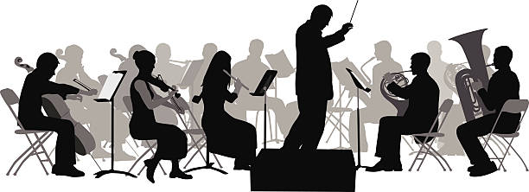
Orchestration

Slide 45
Processor Manager
Command-Oriented
Db
1:Saga makes a booking
2:Saga gets account details
3:Saga sends enriched booking message
Direct Bookings
Accounts
Credit Card
Payments
API
API
API
Orchestration
Bookings Db
Accounts Db
Credit Card Db
Broker
Notes:
This is orchestration, because there is a central controller of the saga. We increase the behavioral coupling over Choreography because we use command->document and not events.
In return we get:
Increased visibility of the operation and the ability to manage
We send a command to book and we add a private reply queue and correlation id, then save the workflow.
Booking makes the booking and returns the id of our booking to us
We wake the workflow indicated by the correlation id and look up the next step
We send a command to accounts to ask for the credit card details and give it a reply queue, then save the workflow
Accounts adds account details to the booking and returns it to us
We wake the workflow indicated by the correlation id and look for the next step
We send a command to payments to pay for the room, and give it a reply queue, then save the workflow
Payments takes the payment and returns the result to us
We wake the workflow and complete it

Slide 46
Processor Manager
1:Saga cancels booking
1:Saga emails customer
1:Saga gets error response
Direct Bookings
Accounts
Credit Card
Payments
API
API
API
Compensation (Error)
Bookings Db
Accounts Db
Credit Card Db
Broker
Notes:
We also get a very explicit compensation flow i.e. When something goes wrong we can raise an exception and have it propagate to reverse the flow. Because the workflow has a request-reation flow, we know that the action has been reversed because we receive confirmations from all the microservices that we have reversed the transaction. Thus we get guarantees around reversal

Slide 47


2:We reserve the booking
Processor Manager
1:User
makes booking
3:User
checks out
4:User
Times Out
Direct Bookings
Accounts
Credit Card
Payments
API
API
API
Reservations
Bookings Db
Accounts Db
Credit Card Db
Broker
Notes:
We might decide that we don’t want to hold the booking of ever, particularly if the use has a number of manual steps to complete and the process manager is controlling that flow.
The user makes the booking, and puts it in their cart. Then they check out, and then they pay for it. We don’t want someone else to take their booking whilst they are checking out, but we don’t want them to walk away leaving us with an unsold room.
The answer is to reserve the room for a period of time, and timeout when that limit is reached, reversing the transaction

Slide 48
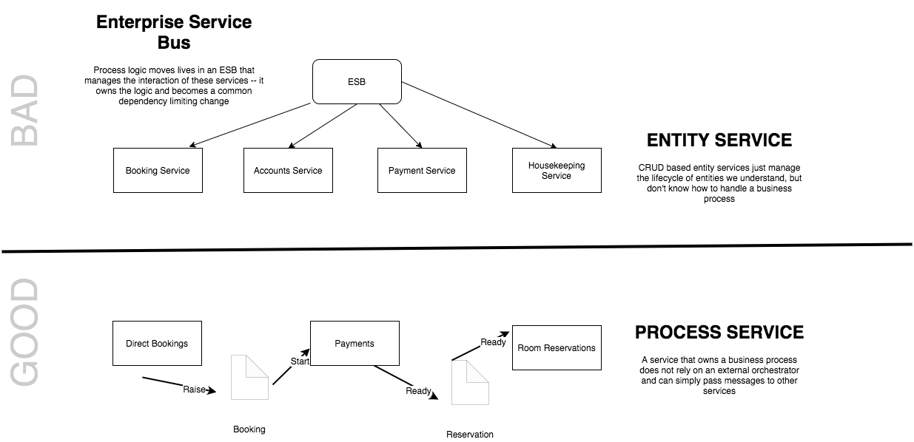
Smart Endpoints and Dumb Pipes
Notes:
“The microservice community favours an alternative approach: smart endpoints and dumb pipes. Applications built from microservices aim to be as decoupled and as cohesive as possible - they own their own domain logic and act more as filters in the classical Unix sense - receiving a request, applying logic as appropriate and producing a response.
The problem with the saga, as opposed to choreography is that it moves logic into the saga, so the endpoints become dumber, at risk of becoming entity services controlled by an orchestrator
”

Slide 49
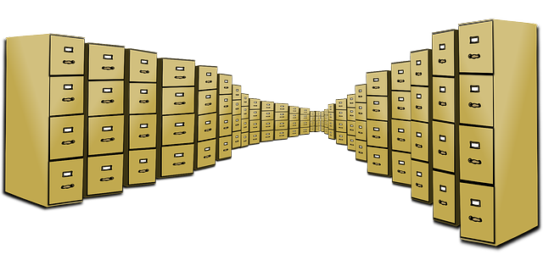
Caching Reference Data

Slide 50
Event:
{ [booking made: {
date:05 JUN
…
}}
Event Carried
State Transfer
Martin Fowler
Accounts
Credit Card Payments
Read Customer info
Notify Downstream Consumers
Worker
Write Payment
Details
Accounts Ref Db
CC Payments Db

Slide 51
See also: Event Driven Collaboration

Slide 52
Done!
Q&A

